Slide 1





Mobile Access Bandwidth in Practice:
Measurement, Analysis, and Implications
Xinlei Yang , Hao Lin, Zhenhua Li, Feng Qian, Xingyao Li, Zhiming He, Xudong Wu, Xianlong Wang, Yunhao Liu, Zhi Liao, Daqiang Hu, Tianyin Xu
Notes:
Hello everyone, I’m Xinlei Yang from Tsinghua University. Today I am going to talk about our work mobile access bandwidth in practice, involving measurement, analysis, and implications.
This is a joint work by Tsinghua Univeristy, Uusense technology, university of Minnesota and UIUC.

Slide 2
Mobile bandwidth is under-delivered in practice
Public reports reveal that the median 5G and WiFi access bandwidths are significantly lower than the theoretical limits
WiFi
137 Mbps
5G
305 Mbps
WiFi 6E
up to 9.6 Gbps
5G
up to 20 Gbps
…
Access
bandwidth
under-delivered
In practice
In theory
Notes:
Recent advances in mobile technologies such as 5G and WiFi 6E claim to support extremely high bandwidth.
These exciting new technologies are the key enabler for numerous emerging applications like metaverse, autonomous vehicles, and UHD videos.
//
In contrast, some public reports reveal that as of late 2021, the median 5G and WiFi bandwidths in China are still fairly low.
Similar situations also exist in the US and Europe.
//
Apparently, the promises of new mobile technologies are significantly under delivered in real-world deployments.

Slide 3
Worse still, bandwidth has decreased in 2021
Our measurement on 3.54M end users shows that the average access bandwidths of 4G/5G decrease remarkably from 2020 to 2021
22%
decrease
11%
decrease
2021
53 Mbps
2020
68 Mbps
2021
305 Mbps
2020
343 Mbps
…
Access
bandwidth
4G
5G
Notes:
Worse still, our measurement on 3.54 million end users shows that // the average 4G and 5G bandwidths decrease remarkably from 2020 to 2021, even with the increasing deployment of 4G and 5G base stations over the past 2 years.

Slide 4
What’s wrong with the current deployments
and
how to reach the theoretical promises?
Notes:
The above surprising results drive us to think about a fundamental question: what’s wrong with the current deployments and how can we reach the theoretical promises?

Slide 5
Contribution
Mobile app-based cross-layer and cross-technology measurement
- capture rich low-level diagnostic information at scale
Revealing the root causes of undesirable access bandwidths
- radio resource migration from 4G to 5G
- dense deployment of 5G base stations in crowded areas
- WiFi bandwidth limited by wired networks
Swiftest: an ultra-fast, ultra-light bandwidth testing service (BTS)
- highly efficient bandwidth probing with statistical guidance
- test time around one second
Notes:
To answer the above question, in this work, we make the following contributions.
First, we devise a novel mobile APP-based cross-layer and cross-technology measurement for capturing rich low-level diagnostic information at scale.
Then, we reveal the root causes of undesirable access bandwidths, including the radio resource migration from 4G to 5G,
dense deployment of 5G base stations in crowded areas, and wired networks that limit the WiFi bandwidth.
Finally, based on the insights obtained from our measurement, we present Swiftest an ultra-fast, ultra-light bandwidth testing service which is featured by highly efficient bandwidth probing with statistical guidance,and can finish a bandwidth test around one second.

Slide 6
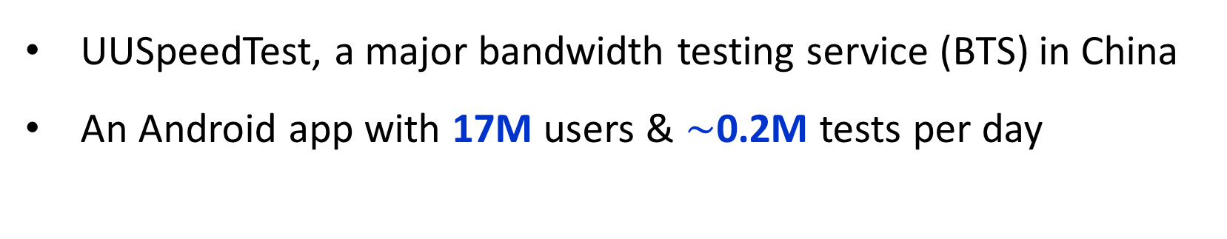
Opportunities
UUSpeedTest, a major bandwidth testing service (BTS) in China
An Android app with 17M users & $\sim$0.2M tests per day
One year collaboration with UUSpeedTest
- large-scale measurement to help understand the root causes
23.6M
Tests
3.54M
End users
2.04M
Base stations
4.47M
WiFi APs
191
Phone vendors
2,381
Device models
Notes:
Specifically, we take a unique opportunity to work with UUSpeedTest, a major bandwidth testing service in China with 17 million active users and performs around 0.2 million tests every day.
//
we collaborate with UUSpeedTest for nearly one year, in order to deeply understand the root causes of the undesirable mobile bandwidth.
During this period, we collect 23.6 million bandwidth tests in total from 3.54 million end users, involving diverse base stations, WiFi APs, phone vendors and device models.

Slide 7

Bandwidth testing method & analysis challenges
Standard “probing by flooding” approach (web-based design)
1. PING test: selecting test server(s)
2. Bandwidth probing: transferring large files via HTTP
3. Bandwidth estimation: sampling throughput statistics
Testing results cannot support in-depth analysis
- coarse-grained results: bandwidth & latencies only
- though its customers are eager to learn the reasons
Notes:
UUSpeedTest adopts the standard “probing by flooding” approach for bandwidth testing, which contains three steps.
//
First, UUSpeedTest runs a PING test to find a nearby server with the lowest latency to the client.
Then the client downloads large files from a test server via HTTP connections for ten seconds.
During this period, the client samples the throughput statistics to finally estimate the bandwidth.
//
Based on the collected data, UUSpeedTest has published several bandwidth analysis reports.
However, due to the its web-based design, UUSpeedTest only collects coarse-grained data like bandwidth results and latencies during a bandwidth test.
This prevents it from pinpointing the root causes of the undesirable mobile access bandwidth, even though the customers are eager to learn.

Slide 8
Cross-layer and cross-technology measurement
Web-based → mobile app-based: passively and selectively collecting PHY- and MAC-layer information through standard Android APIs
A lightweight plugin for UUSpeedTest with no additional privileges and negligible CPU/memory overhead
LTE band,
Cell bandwidth,
EARFCN code,
...
5G band,
Cell bandwidth,
NRARFCN code,
...
WiFi standard,
Max TX/RX Linkspeed,
Current Linkspeed,
...
MAC layer
Signal strength,
SNR,
RSSI,
...
Signal strength,
SNR,
RSSI,
...
WiFi RSSI,
WiFi frequency,
Channel width,
...
PHY layer
4G
5G
WiFi
Notes:
To address the above, we transform the original web-based design into a mobile app-based design. Specifically, we devise a cross-layer and cross-technology measurement that passively and selectively collects physical and MAC-layer information through standard Android APIs.
Our enhancement is implemented as a lightweight plugin for UUSpeedtest with no additional privileges and negligible CPU and memory overhead.

Slide 9
Our key finding
From 2020 to 2021, the average 4G/5G access bandwidths decrease by 22% and 11%, while the average WiFi access bandwidth remains largely unchanged (3.6% increase)
Notes:
Through our analysis on the collected data, the key finding is that, over the past two years, despite the increasing deployment of WiFi 6 and 5G, the average 4G/5G access bandwidths decrease remarkably, while the average WiFi access bandwidth remains largely unchanged.
To deeply understand the root causes, we now zoom into different access technologies.

Slide 10
4G
5G
WiFi
4G bandwidth decrease due to spectrum refarming
Part of LTE Bands B28, B1, B41 are refarmed for 5G use
The original 4G workloads are crowded in the remaining LTE bands, leading to the decrease in 4G access bandwidth
Notes:
First, for 4G network, we find that the bandwidth decrease is caused by the spectrum refarming from 4G to 5G.
Specifically, as shown in the figure, there are in total nine LTE-bands used in China.
In 2021, part of the three LTE bands are “refarmed” for 5G use.
//
Consequently, the original 4G workloads are now crowded in the remaining LTE bands, leading to the sharp decrease in the 4G access bandwidth.

Slide 11


4G
5G
WiFi
LTE-Advanced brings high 4G access bandwidth
6.8% LTE bandwidth test results $≥$300 Mbps (comparable to 5G)
Benefit from LTE-Advanced key functionalities, e.g., carrier aggregation (CA), enhanced MIMO, Coordinated Multi-Point Tx/Rx (CoMP), relay nodes
Deployed alongside urban main roads to cope with large traffic volume
Carrier 1
eNodeB
Carrier 2
CA
data
pipe
Aggregated
carrier
Carrier 3
Carrier 4
UE
eNodeB
major urban roads
Carrier aggregation
LTE-Advanced base station
Notes:
Thankfully, there are still 6.8% LTE tests whose bandwidth exceeds 300 Mbps, which is comparable to commercial 5G.
//
This is enabled by LTE-Advanced technology, which employs several innovations like carrier aggregation (CA), enhanced MIMO, CoMP, and relay nodes.
Here, carrier aggregation is a key technique used by LTE-Advanced. It merges separated frequency resources called carriers together to increase the bandwidth.
//
Currently, LTE-Advanced base stations are mainly deployed alongside urban main roads in China to cope with large traffic volume.

Slide 12
4G
5G
WiFi
Spectrum refarming also decreases 5G bandwidth
Fragmented spectrum resource of refarmed 4G→5G bands (N28, N1)
Low max channel bandwidth
Low 5G access bandwidth
Dedicated Band
Refarmed Band
Notes:
As to 5G, it is unfortunate to see that spectrum refarming also plays a negative role on access bandwidth.
Specifically, the refarmed 5G bands N28 and N1 have very fragmented spectrum resources.
//
As a result, the max channel bandwidth of these two bands are only 20 megaherz, which is 5 times lower than other 5G bands.
//
This further leads to the low average 5G bandwidth on these two bands, which are 113
and 103 Mbps respectively.
As we can see, although spectrum refarming is inevitable, as cellular technology evolves, the current LTE spectrum resources are severely fragmented.
This makes contiguous high-bandwidth spectrum available for refarming, rather scarce, leading to low 5G bandwidth as shown in our data.

Slide 13
4G
5G
WiFi
Carrier aggregation (CA) is not a panacea
Most 5G devices/base stations in China support multiple CA techniques
- TDD-TDD CA (2.6GHz + 4.9GHz) & TDD-FDD CA (700MHz + 2.6GHz or 2.1GHz + 3.5GHz)
Two-fold realistic problems
- design difficulties: harmonic disruption, RF de-sense, UE/BS energy consumption
- runtime overheads: scheduling/power control info, CRC, UE feedbacks, L2/L3 signaling
Notes:
At this point, some of you might ask: can carrier aggregation address the spectrum fragmentation for 5G?
Well, in fact, most 5G devices/base stations in China already support multiple carrier aggregation techniques.
//
However, carrier aggregation faces two-fold realistic problems.
First, orchestrating different carriers can easily induce harmonic disruption and RF de-sense, and induce more energy consumption for both user equipments and base stations.
Besides, more extra information is required for maintaining the proper data transfer across multiple carriers in parallel.

Slide 14
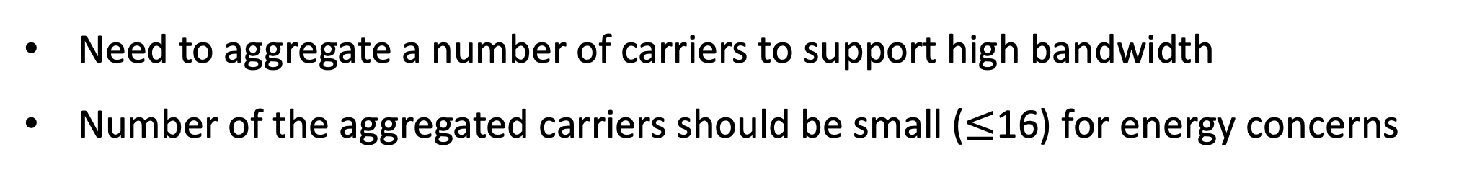
4G
5G
WiFi
CA is more challenging in 5G
Need to aggregate a number of carriers to support high bandwidth
Number of the aggregated carriers should be small ($≤$16) for energy concerns
30MHz
20
MHz
25
MHz
758MHz
788MHz
2110MHz
2130MHz
2155MHz
ISP-1
160MHz
ISP-2
2515MHz
2675MHz
ISP-3
100MHz
100MHz
100MHz
ISP-4
3300MHz
3400MHz
3500MHz
3600MHz
100MHz
60MHz
4800MHz
4900MHz
4960MHz
5G spectrum currently used by ISPs in China (downlink only)
Notes:
Sadly, the above problems are magnified in 5G, which makes carrier aggregation even more challenging.
On one hand, the 5G spectrum resources in China are rather fragmented.
As shown, quite a part of spectrum resources especially those with low frequency cannot support 100Megahurts channel bandwidth. Worse still, some spectrum like 3300 to 3400 Megahurtz are shared by three different ISPs, which further aggravates the spectrum fragmentation.
this means CA needs to aggregate a number of carriers to support high bandwidth of 5G.
On the other hand, the number of the aggregated carriers should be small ($≤$16) for energy concerns.
Therefore, such delimma limits the performance gain brought by carrier aggregation for 5G.

Slide 15
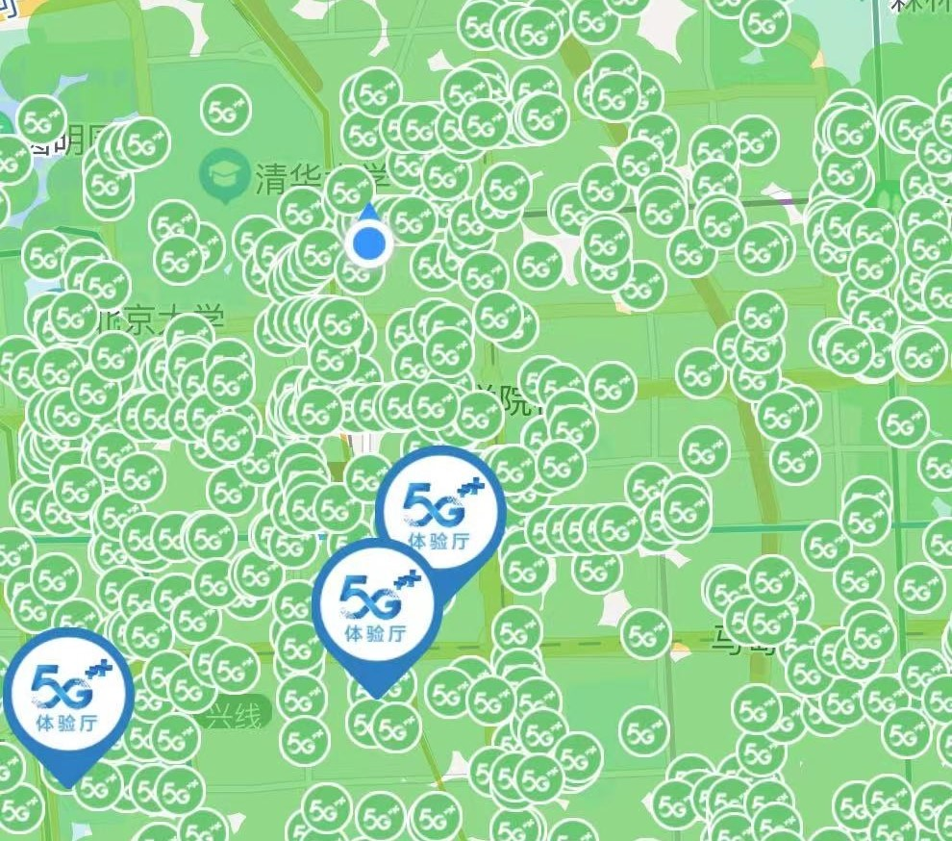
4G
5G
WiFi
Stronger RSS $≠$ higher 5G access bandwidth
Strong received signal strength (RSS) level does not necessarily translate into high 5G access bandwidth
Dense deployment of 5G BSes in crowded urban areas
Cross-region coverage, multi-path and co-channel interference,
load balancing issues, and poor handover problems
A 5G BS
5G
5G BSes around our campus
Notes:
In addition, we also notice that a stronger RSS level does not necessarily translate into higher 5G access bandwidth
In particular, as shown in the left figure we notice that the average 5G bandwidth under excellent RSS is lower than that under weaker RSS.
//
This is because the tests under level-5 RSS are mainly performed in crowded urban areas, where the dense base station deployment induces multiple problems like cross-region coverage, multi-path and co-channel interference, load balancing issues, and poor handover problems

Slide 16
4G
5G
WiFi
WiFi bandwidth is limited by wired access
132 Mbps (2020) → 137 Mbps (2021)
WiFi access bandwidth tends to cluster around certain 100x values, which well match ISPs’ fixed broadband plans
Around 64% are using $≤$200 Mbps fixed “broadband” Internet access
100
300
500
Bandwidth distribution of WiFi 5
Notes:
finally for WiFi access, the average bandwidth slightly increases over the past two years.
however, it doesn’t match the rapid increase in the deployment of WiFi 5/6.
//
Deeper analysis shows that the WiFi access bandwidth tends to cluster around certain hundred values, which interestingly well match the ISPs’ typical fixed broadband plans.
//
Meanwhile, according to ISP’s public reports, around 64% WiFi users, are still using no higher than 200 Mbps fixed “broadband” in China.
This implies that the technical advantages of WiFi 5/6 are in fact largely offset by the tardy evolution of wired access.

Slide 17
Takeaways for different stakeholders
To ISPs and content providers
- adopt effective band defragmentation and refarming strategies
- widen the deployment of the LTE-Advanced technology
- consider new access technologies when budgeting network infrastructure
To common users
- be rational about ISPs’ and phone vendors’ 5G advertisement campaigns
To BTS providers
- deep insights on mobile access bandwidth can help greatly improve BTS design
- real-world implementation and deployment of an ultra-fast, ultra-light BTS
Notes:
Combining the above analysis of 4G, 5G and WiFi network, our findings bring implications to different stakeholders in the mobile ecosystem.
First, we suggest that effective band defragmentation and refarming strategies should be adopted for 4G and 5G.
Also, it is wise to widen the LTE-Advanced deployment for 4G network.
Moreover, we advocate that the ISPs and content providers should think more about the emerging wireless technologies ,when budgeting their network infrastructure.
In addition, we appeal to common users to be rational about ISPs’ and phone vendors’ 5G advertisement campaigns
Finally, we surprisingly find that our deep insights can help greatly improve BTS design.
Now I am going to introduce how we managed to do this in more detail.

Slide 18
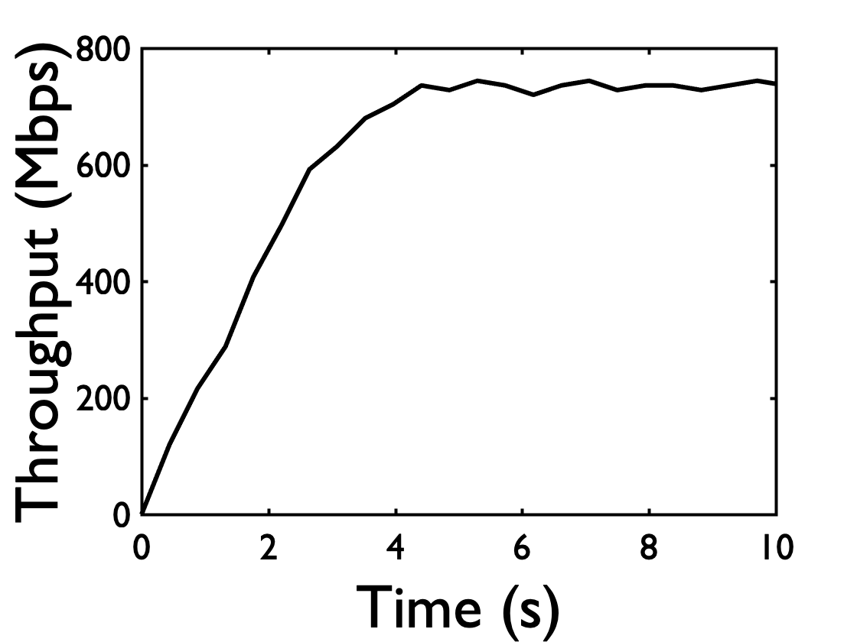
Observations from real-world measurements
TCP slow start accounts for a long time of bandwidth tests for high-speed networks, but does not contribute useful bandwidth samples
Each access technology’s access bandwidth follows a stable multi-modal Gaussian distribution (GMM model)
TCP slow start
4.3 seconds
A typical 5G
bandwidth test
5G
WiFi 5
Notes:
We make two key observations from our data.
First, TCP slow start accounts for a significant fraction of time of a bandwidth test especially for high-speed networks like 5G.
However, it does not contribute useful bandwidth samples.
//
To address this, our key finding is that mobile access bandwidth can be well modeled by a multi-modal Gaussian distribution for a given access technology.
Note that these distributions are not coincidences but produced by the joint impact of bandwidth limits, infrastructure status, and ISPs’ data plans.

Slide 19
Bandwidth probing with statistical guidance
Lengthy, expensive calibration
of initial probing bandwidth
Swift, precise probing guided by GMM models
Key idea:
Use the most probable bandwidth in the GMM model to start up
Fine-tune the probing rate based on client feedback
Notes:
Guided by the above, we replace TCP slow start’s lengthy, expensive calibration of initial probing bandwidth with a swift, precise probing process guided by GMM models.
//
The key idea is to first use the most probable bandwidth in the GMM model to start up, and then fine-tune the probing rate based on client feedback for fast convergence

Slide 20
An example of a 5G bandwidth test
Test servers
Client
“Modal” bandwidths for 5G
[172, 289, 485, 806] Mbps
Probing
start
Probing rate: 289 Mbps
Collecting
bandwidth samples
Bandwidth reaches 289 Mbps
Increasing
rate
Probing rate: 485 Mbps
Collecting
bandwidth samples
Bandwidth reaches 485 Mbps
Increasing
rate again
Probing rate: 806 Mbps
Bandwidth converge
Converged!
Probing
end
Notes:
Take a typical 5G bandwidth test as an example.
//
To start up, the test servers select a most probable bandwidth as the initial probing rate according to the client’s access type.
During the test, the client keeps collecting bandwidth samples.
//
Once the bandwidth reaches the probing rate, the client notifies the test servers.
//
Then the test servers increase the probing rate to the next probable modal bandwidth.
Such process goes on until the client bandwidth finally converged.

Slide 21
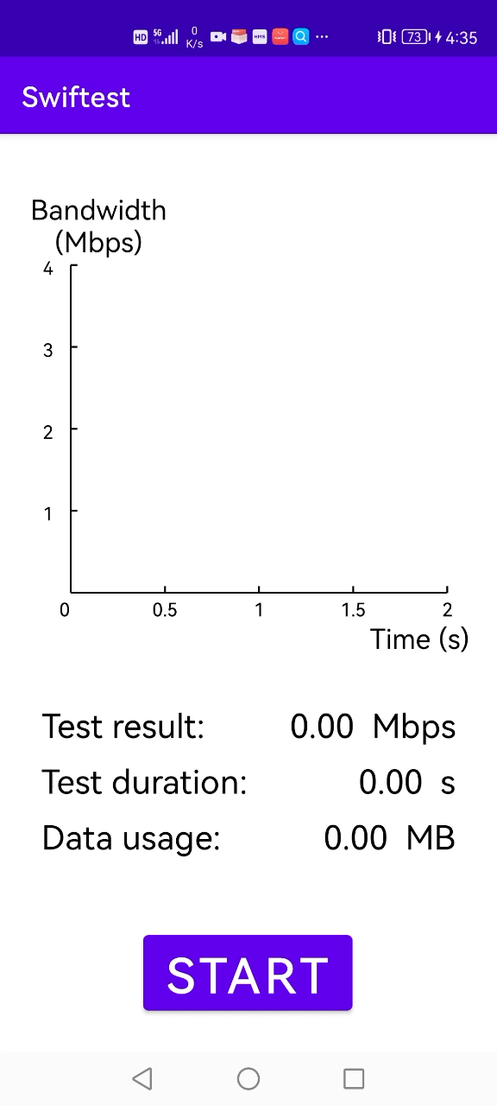
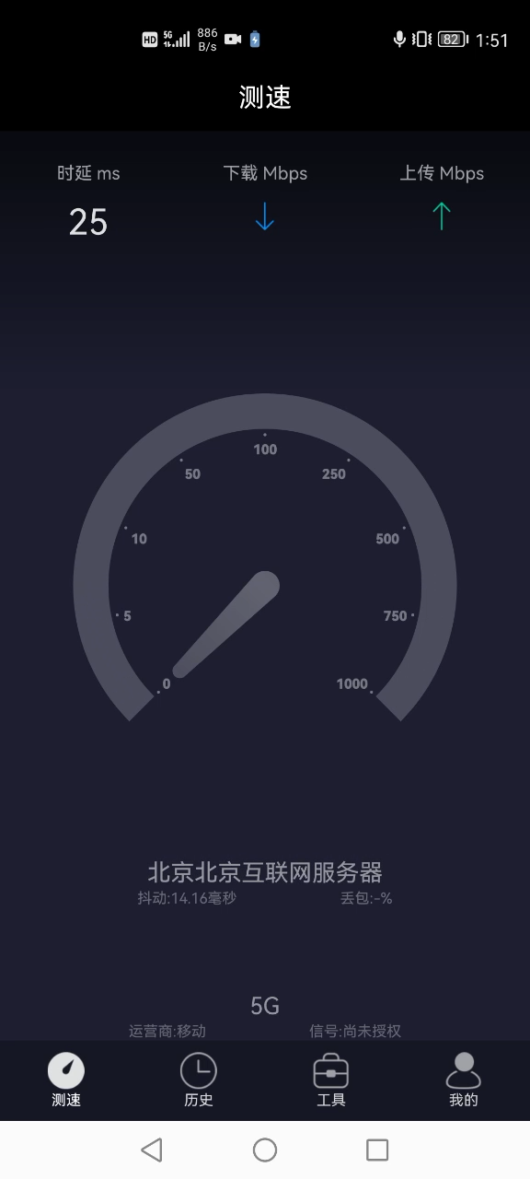
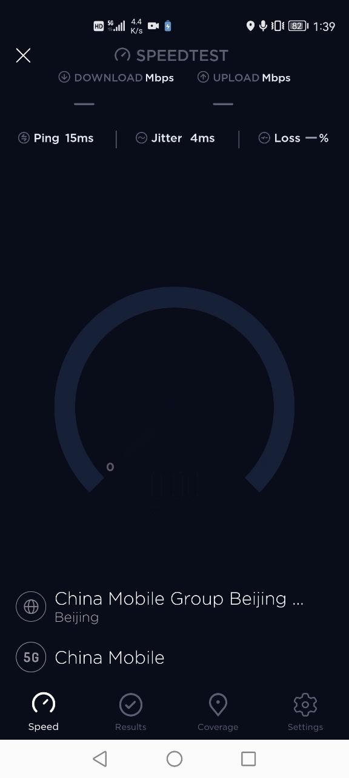

Swiftest: ultra-fast, ultra-light BTS
352 1-10Gbps servers (UUSpeedTest) → 20 100-Mbps servers (Swiftest)
5G network, $\sim$800 Mbps access bandwidth
Swiftest
UUSpeedTest
Speedtest
Latency ms
Downlink Mbps
Uplink Mbps
Similar test accuracy, >10$×$ shorter test time & less data traffic
Beijing Internet Servers
Jitter: 50 ms
Loss: -%
Duration: 0.81 second
Result: 776 Mbps
Data usage: 69.8 MB
Duration: 10 seconds
Result: 792 Mbps
Data usage: 722.5 MB
Duration: 11.7 seconds
Result: 786 Mbps
Data usage: 1014 MB
Test
History
Tools
Me
Notes:
We implement the above approach into an ultra-fast, ultra-light BTS called Swiftest.
Swiftest is deployed on only 20 test servers, whose infrastructure is more than ten times smaller than that of UUSpeedTest.
//
Here we present a demo to directly compare the performance of Swiftest, UUSpeedTest, and SpeedTest.
As shown, Swiftest significantly outperforms the other two BTSes by yielding similar test results, but incurring more than 10 times shorten test duration and less data traffic.
We also conduct both large-scale, real-world evaluation and in-depth benchmarks with other BTSes in order to comprehensively evaluate the performance of Swiftest. For more details, please refer to our paper.

Slide 22


Conclusion
Deeply characterizing 3.54M real-world users’ mobile access bandwidth using cross-layer and cross-technology measurement
Revealing the root causes of undesirable mobile access bandwidths
Providing useful implications to ISPs, content providers, and users
Building an ultra-fast, ultra-light approach to bandwidth testing service that can finish a test around one second
https://mobilebandwidth.github.io/
link to artifacts
Notes:
To summarize, in this work, we deeply characterize 3.54M real-world users’ mobile access bandwidth using cross-layer and cross-technology measurement.
Then, we reveal the root causes of the under-delivered access bandwidth and provide implications to different stakeholders in the mobile ecosystem.
We also build an ultra-fast, ultra-light bandwidth testing service that can finish a test around one second.
The data and code are publicly available.
That’s all, thanks for your attention and I’m now ready for your questions.

